Slide 1
TIES4560 Demo 5
Suvi Kaasalainen,
Leevi Liimatainen,
Petra Puumala,
Teemu Vähä-Impola

Slide 2
Task-5.1: Application deployment to Cloud
Different tasks were deployed to different cloud platforms:
Task-1: Web client to remote SOAP web service - Google Cloud
Task-2: Jetty based Web service (including deployment of own SOAP web service implementation) - Heroku
Task-4: REST web service - IBM

Slide 3

Google Cloud Platform
Task-1 was deployed to Google Cloud Platform:
First step was to sign in and enable Google Cloud Platform with your Google account.
Free 365-day trial period with about 300 euros worth of credits (everything is billed).
Billing has to be enabled before deploying apps.
After signing in the first project can created in one of three ways:
Through web browser on the cloud platform (used in this task),
Through Google CLI (needed if you want to deploy from Git or a Maven project) OR
Through Eclipse’s Google Cloud Tools.
After creating the project, the easiest way to deploy an app was to use Eclipse’s Google Cloud Tools, found through Marketplace:
This way you can deploy a the app as WAR/executable JAR file (also requires an app.yaml file).
Deployment takes about 5 - 10 minutes if no errors occur.
Biggest issue with deployment was compatibility of Java versions (required Java 8).
Problem was solved by applying Java 8 to Task-1 and then exporting it as WAR-file.
https://mycalculator666.appspot.com/ (mycalculator was already in use)

Slide 4
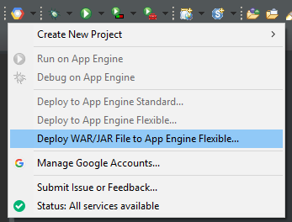
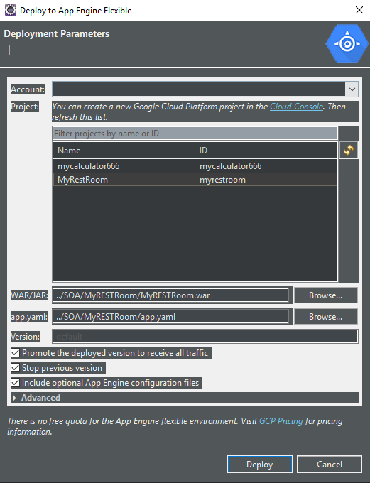
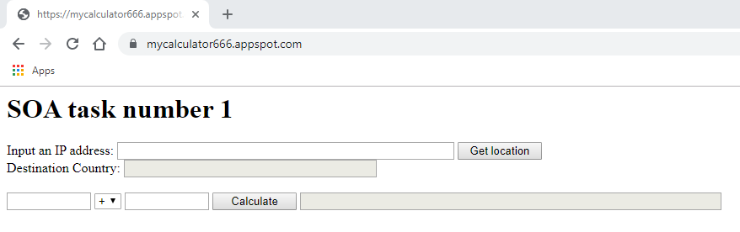
Google Cloud Platform
Result:

Slide 5
Heroku Platform
Task 2 was deployed to Heroku:
Register to Heroku
Install Heroku CLI
Also requires Git and Apache Maven
Heroku uses OpenJDK 8 to run applications by default
We changed our applications to run on Java 8
Other option is to specify Java version in system.properties file in your application
Free dynos sleep after 30 minutes of inactivity. This causes a delay of a few seconds for the first request upon waking

Slide 6
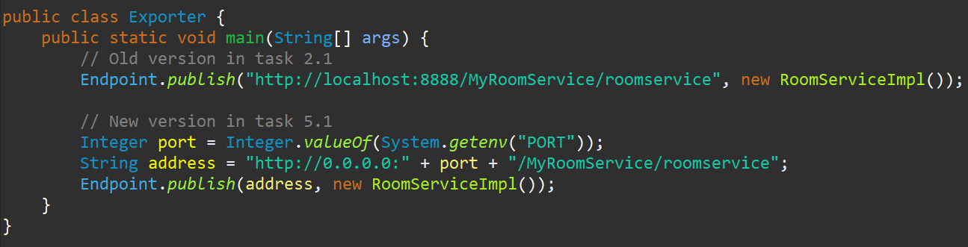
SOAP Service in Heroku
Our SOAP service was implemented as simple Java Project (didn’t use cfx)
Added MANIFEST.MF file to the project to declare main class (Exporter.java)
Changed the server and port declarations
Created jar-file

Slide 7
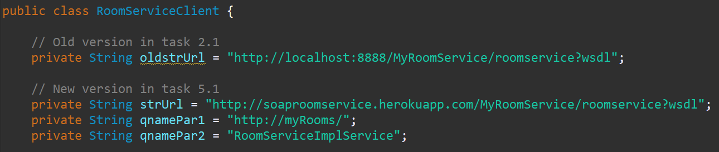
Web Service with Jetty using SOAP Service
Simple steps to deploy in Heroku CLI:
heroku create soaproomservice
heroku plugins:install heroku-cli-deploy
heroku deploy:jar <path-to-jar-file> --app soaproomservice
https://soaproomservice.herokuapp.com/MyRoomService/roomservice?wsdl

Slide 8
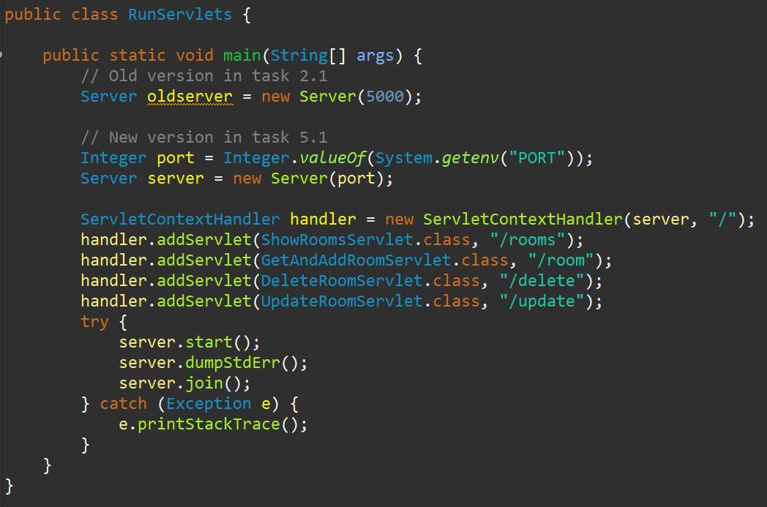
Jetty Service to Heroku
Changed server and port declarations
Created runnable jar
Same 3 commands in Heroku CLI as before
heroku create jettyroomservice
heroku plugins:install heroku-cli-deploy
heroku deploy:jar <path-to-jar-file> --app jettyroomservice
https://jettyroomservice.herokuapp.com/rooms (use with e.g. Postman)

Slide 9
Task 1 and 4 to Heroku
We deployed also Task 1 to Heroku:
https://curconvertter.herokuapp.com
and Task 4:
https://myrestroom.herokuapp.com/rooms
(e.g. with Postman, authorization needed)
Deployed with war-files, no code changes needed

Slide 10
IBM Cloud Platform
Task 4 was deployed to IBM Cloud:
Step 1) register to IBM Cloud
Step 2) download and install the IBM Cloud CLI
Step 3) login from command line: ibmcloud login
Step 4) run command ibmcloud target --cf to identify the org and space
Step 5) change directory where your code is located and then use command
ibmcloud cf push. Either use a manifest file or type flag -m 256M. (Free account memory limit will make pushing fail without this).
Step 6) use service https://restroomservice2.eu-gb.mybluemix.net/ for example from Postman.

Slide 11
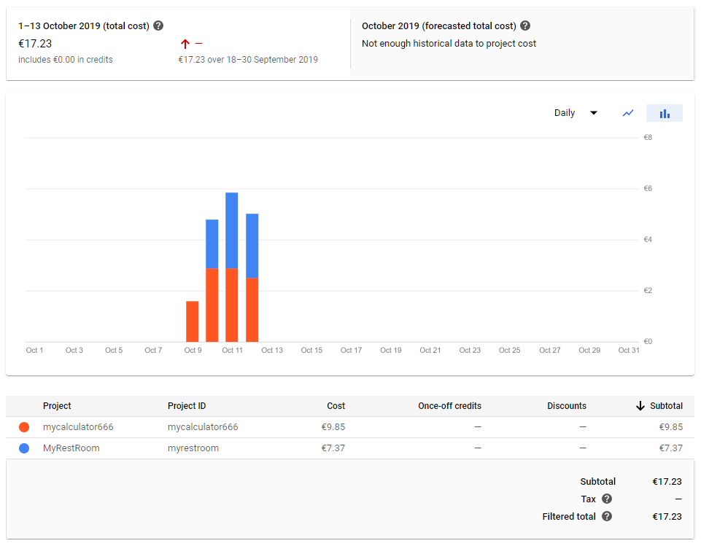
Google Cloud Platform
For educational purposes, we deployed Task 4 to Google Cloud as well.
Within four days, the billing graph looked quite alarming:
- 17.23€ spent with almost no traffic at all.
- The free trial period ends when all the free credits are used or after 12 months have passed.
- After trial period, some minor functions will be available for no cost.
- Actual usage of Google Cloud seems costly, but pricing is on par with AWS.

Slide 12
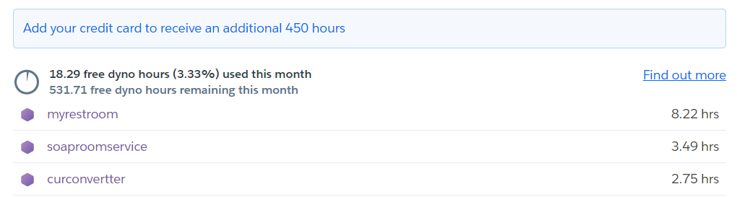
Heroku

Slide 13

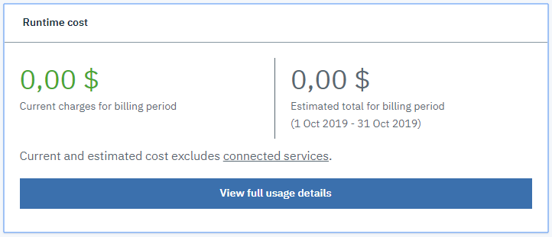
IBM Cloud Platform
in camp IBM...

Slide 14
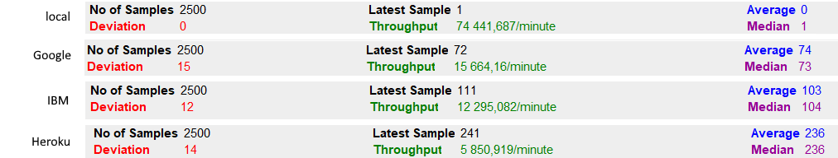
JMeter measurement
In all the cases :
We used in testing GET-request to get list of all rooms in our service.
As thread properties we used: number of threads: 25, Ramp-up period: 2, Loop count: 100 → total number of requests 2500
Cloud performance was compared to locally-run service
Results were best (like expected) when running locally. Throughput was highest and response times lowest.
2nd best performance was when REST web service was run on Google cloud
3rd best on IBM
4th on Heroku

Slide 15
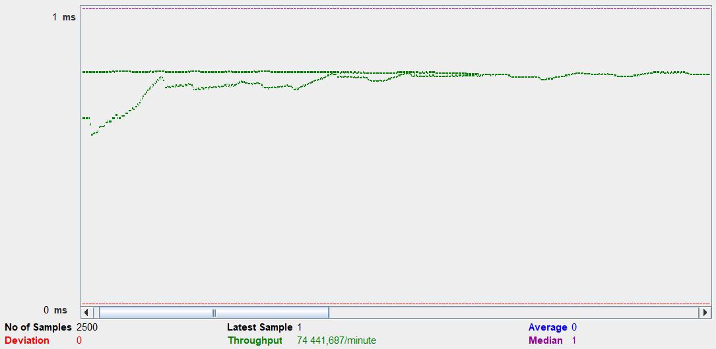
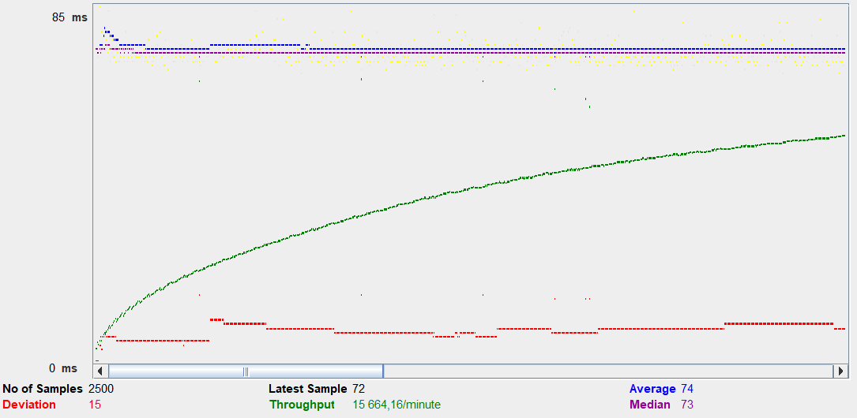
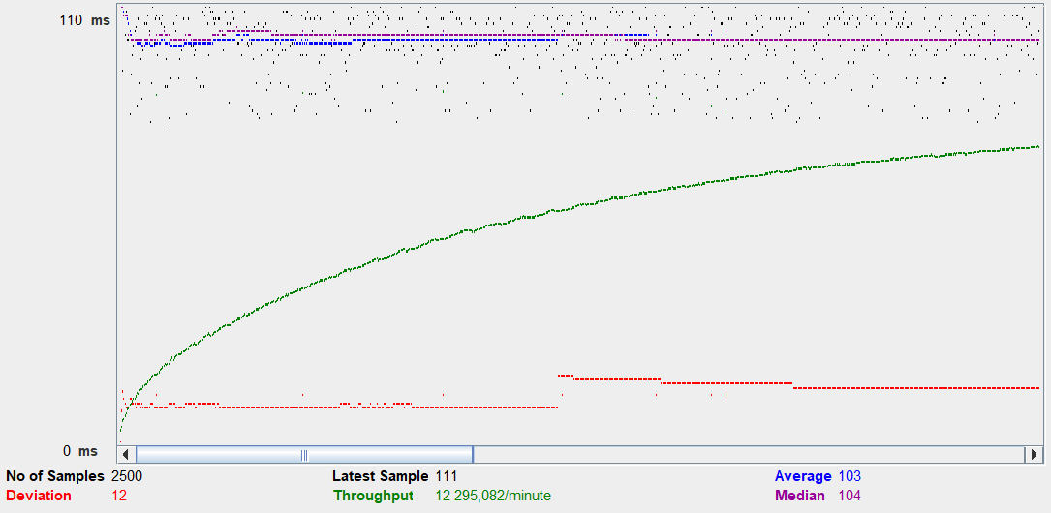
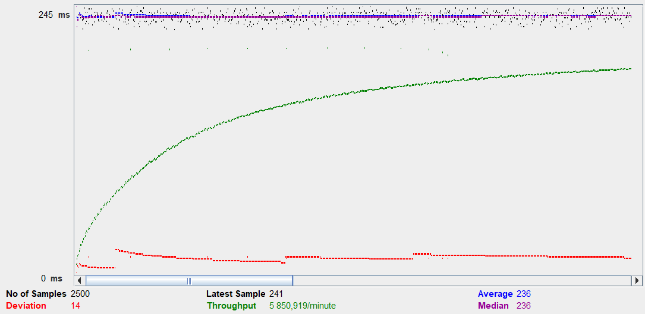
Local
Google
IBM Heroku

